Slide 1
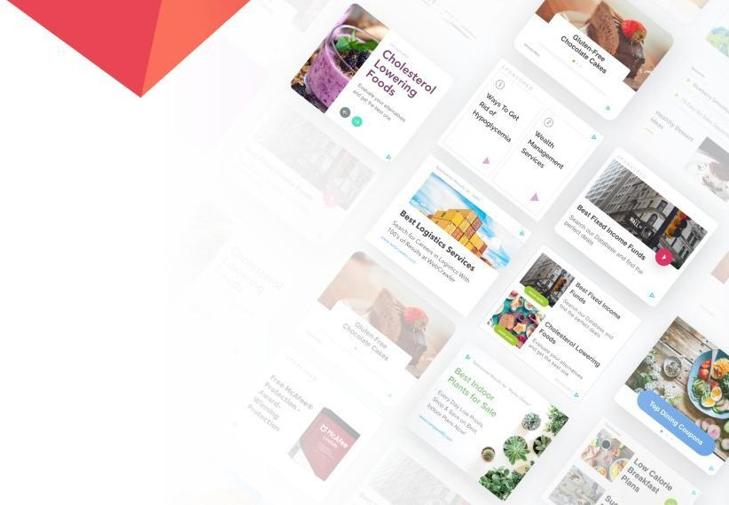
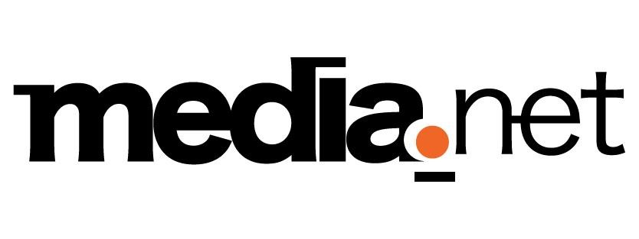

Slide 2
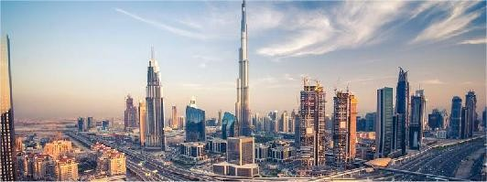






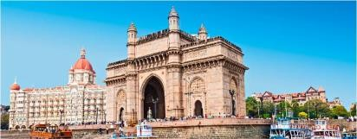


Who we are
DUBAI
Largest independent contextual advertising company globally (2nd only to Google AdSense). Also, one of the largest independent software distribution companies globally.
NEW YORK
Most comprehensive portfolio of advertising technology in the industry, with several technology solutions in use by large blue-chip companies. Builds tech that supports publishers, advertisers and end users all across the world.
SAN FRANCISCO
Focused on client growth, custom solutions and service delivery with 600+ world class engineers and 700+ client services staff.
Media.net’s CEO Vaibhav Arya's on Identity, Privacy and Contextual in a Rapidly Changing Marketplace | IAB - https://www.iab.com/video/live-stream-with-media-nets-vaibhav-arya/
LOS ANGELES
1400+
Employees Globally
MUMBAI
1B+
Ad Clicks Managed annually
500M+
URLs
monetized annually
50+
Demand Partners
FRANKFURT
BEIJING

Slide 3
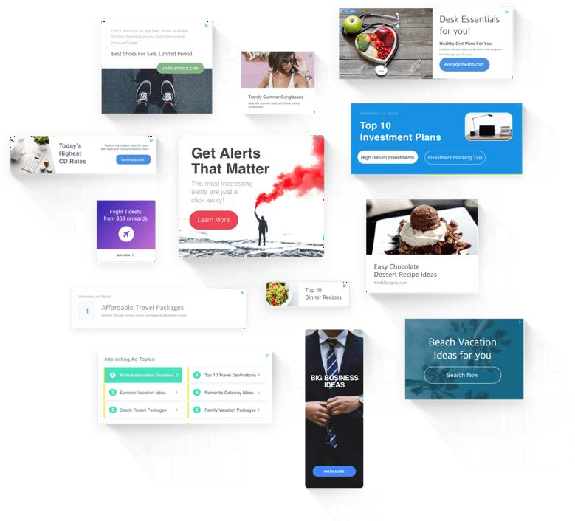















What we do
A constantly expanding catalogue of formats and mediums
Serving a wide range of ad formats
Text
Search
Product
Display
Emails
Local
Mobile
Native
Video
Monetizing multiple mediums and devices
Websites- Desktop, Mobile, Tablet & TV
ISP Services, DNS Search & Domains
Ad Quality Tools
Mobile Apps
Emails & Lead Generation
Consumer Research
Digital Marketing
–SEO&+SEM
Browser Extensions & Downloadables
Tech Licensing

Slide 4





















Influential Publisher Relationships

Slide 5



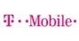


















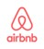









Blue Chip Advertisers
Selected Direct Advertisers
$7 Bn+ demand from Yahoo/Bing

Slide 6

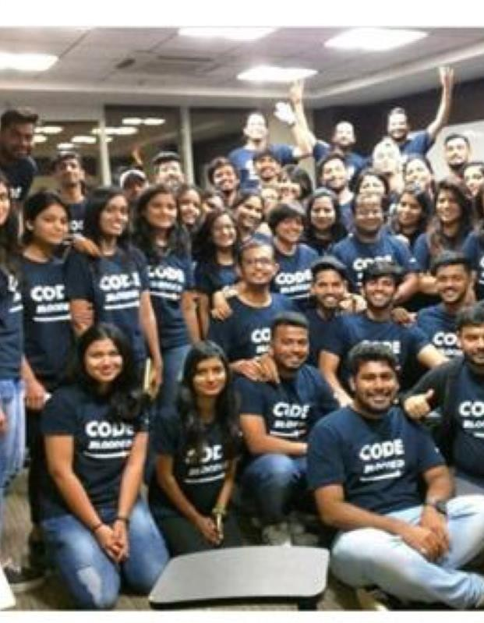
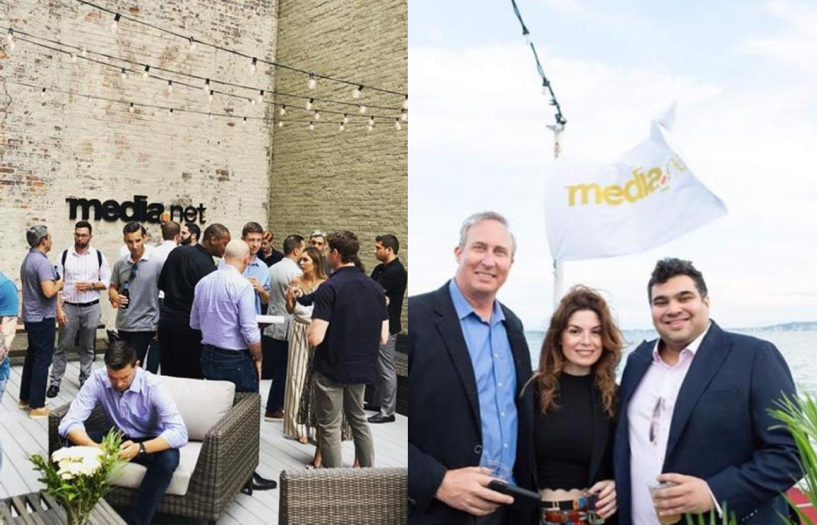
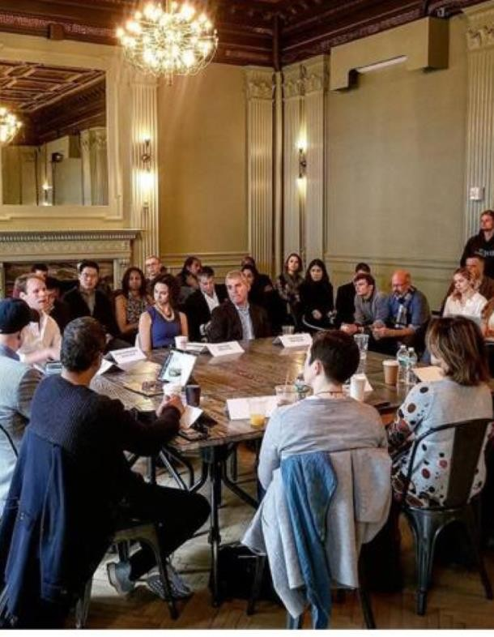

Investing in people
1400+ employees
across the world split into agile teams with skill-depth across functions
700+ world-class engineers exclusively dedicated to bettering the future of AdTech
Regularly compared to Google, Microsoft, Facebook and Amazon for recruitment and employer attractiveness in India

Slide 7
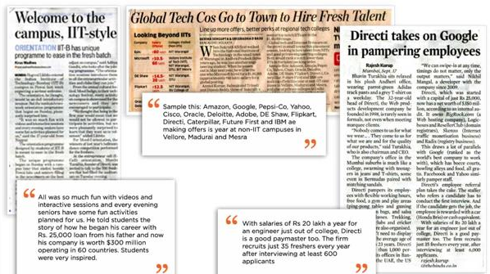

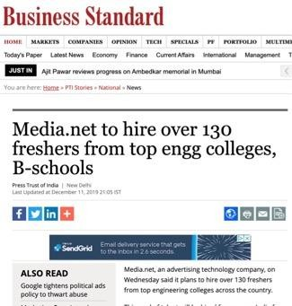
Recruiting Top Talent
Under our recruitment brand name, Directi, we compete and win for top global talent

Slide 8





Recruiting Top Talent
Continually compared by mainstream media to Google, Microsoft, Facebook and Amazon with regard to its
people quality and HR practices. Consistently a day 0 or day 1 recruiter on top-tier campuses
“Prominent recruiters in the technology space included Microsoft, Microland, WNS, MindTree, Texas Instruments, Sutherland Global, Walmart Labs, Lenovo, Juniper Networks and Directi among others…”
“Flipkart was the second highest recruiter with six offers at Rs 14 lakh each. Other major recruiters include Oracle, Directi, Deloitte, Mu Sigma, Thorogood, Futures First, Kuliza Technologies and MAQ Software.”
“New recruiters or old recruiters returning to campus included HSBC Markets, Macquarie Group, Rocket Internet, IDG Ventures, DBS, Saint Gobain, Snapdeal, PwC Diamond, and Directi.”
“Others who have offered PPOs, include Schlumberger,
Directi, Adobe, Reliance, Shell Technology, Cadbury, Qualcomm, Deutsche Bank, Credit Suisse, … Samsung, VMWare, … LinkedIn, … Goldman Sachs (Tech) Intuit,
Futures First and P&G.”

Slide 9
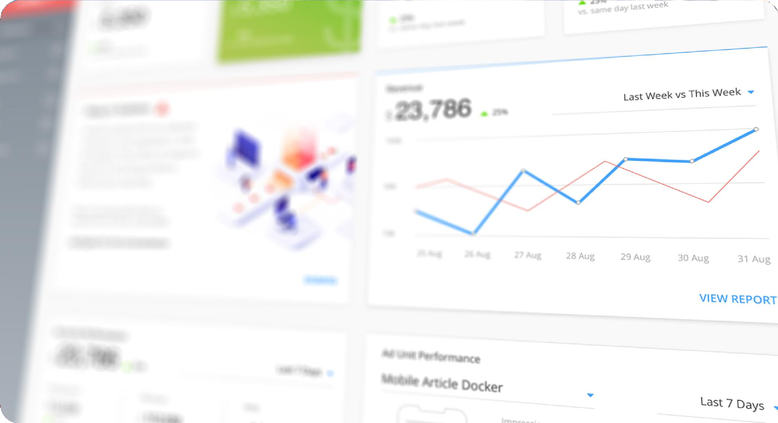


UI Developer

Slide 10
What’s in it for me?
You will be responsible for building world class Ad-tech products, reporting tools and data applications.
You will take a key role in our team, to create intuitive and innovative user experiences and is involved in all stages of software development.
We are looking to add a rock star 'UI Developer' to our team! As a ‘UI Developer' you are accountable for functional, comprehensive and pixel-perfect user interface for our web and mobile application.
If you are passionate about UI development for next-gen software applications that solve problems that matter and wow the users with an amazing user interface, this job is for you.

Slide 11
What is the Team Like?
As a Front end developer, you will be a part of a passionate team of developers and work towards creating clean and artful design, translate high-level requirements into interaction flows and artifacts, and transform them into beautiful, intuitive, and functional user interfaces.
We​ ​are​ ​a​ ​team ​thriving​ ​on​ ​young​ ​energy,​ ​on​ ​mentorship,​ ​craziness,​ ​drive​ ​and commitment​ ​to​ ​making​ ​a​ ​difference
You will play a key role in our team, to create intuitive and innovative user experiences and is involved in all stages of software development.
.

Slide 12
Roles & Responsibilities
Opportunity to develop game-changing, globally distributed, internet advertising products used by millions worldwide.
Contribute hands-on, own, collaborate, and deliver new features and services at a fast pace.
Build platforms, frameworks, APIs, libraries & automated tools to facilitate rapid issue resolution and development & deployment of new features and changes.
Own the prioritization, scoping and scheduling processes for new products and features.
Work with and advise management on technical aspects, make well-informed decisions.
Improve processes, technology & the applications you own continuously by showing the team better ways of doing things and help improve skills in the team.
Prioritize tech-debt and ensure the platforms and applications meet the latest industry standards.
Learn new technology & practices, coach the team and conduct training sessions – devote time for learning and continuous improvement of self and team.
Imbibe and maintain a strong customer service-oriented attitude while designing and building products.

Slide 13
Ideal Candidate
We like people with strong educational qualification (B.Tech, BE, BSC.IT, MCAs).
2-4 years of demonstrable experience developing software using modern Frontend technologies (ES6, React, Webpack/Babel etc)
Ability to understand and resolve issues with dependencies.
Expertise in building complex layouts with modern CSS (Grid/Flexbox) and HTML.
Experience building and debugging complex, real-time systems in a team environment.
Strong UX and design sensibilities, and a desire to sweat the smallstuff.
Self-awareness and a desire to continually improve.
Strong interpersonal communication skills, a positive attitude, and a hunger for growth.
Bonus Points:
Experience working with Babel/Webpack/Gulp.
Experience investigating and improving JavaScript performance.
Experience with Web Sockets, Local Storage and ES6.
Familiarity with scalable, real time distributed systems.
We highly value contributions to open source projects; is there a public source repository or project that you are particularly proud of?
Testing frameworks (Chai, Mocha, Enzyme, or Jasmine)

Slide 14
Interview Process
Talent Acquisition Outreach-HR Starts a Conversation
Onsite Interview (Google Hangouts/Skype)
Each Round is an Elimination Round
Round 1 : This round is an Assignment round evaluating code quality and deployment
Round 2: The focus here will be on tech i.e html, css and javascript
Round 3: This will be the final round based on advance level tech i.e html ,css and javascript
P.S : The above mentioned is a generic process ,it is subject to change based on experience range, background ,specific role/team being hired for .

Slide 15
Benefits and Culture
At Media.Net people love their jobs, and not just because we offer the most competitive salaries in the industry. Our excellent benefits include everything from great medical and life insurance to catered meals. Our workspaces are comfortable and fun, complete with bean bag chairs, ping pong tables, and all the snacks you can eat. We have no dress code (tee-shirts are a-ok!).We have flexible work hours and flexible holidays, which means that teams pick their own work hours.
Media.Net has its own concierge desk that doubles up as a travel agency. We are passionate about building the next generation of web products, and we believe that happy employees are the key to achieving this goal. If you like the idea of working in an exciting workspace on cutting-edge internet products that make a truly global impact (and wearing flip-flops to work), then we want to get to know you!

Slide 16
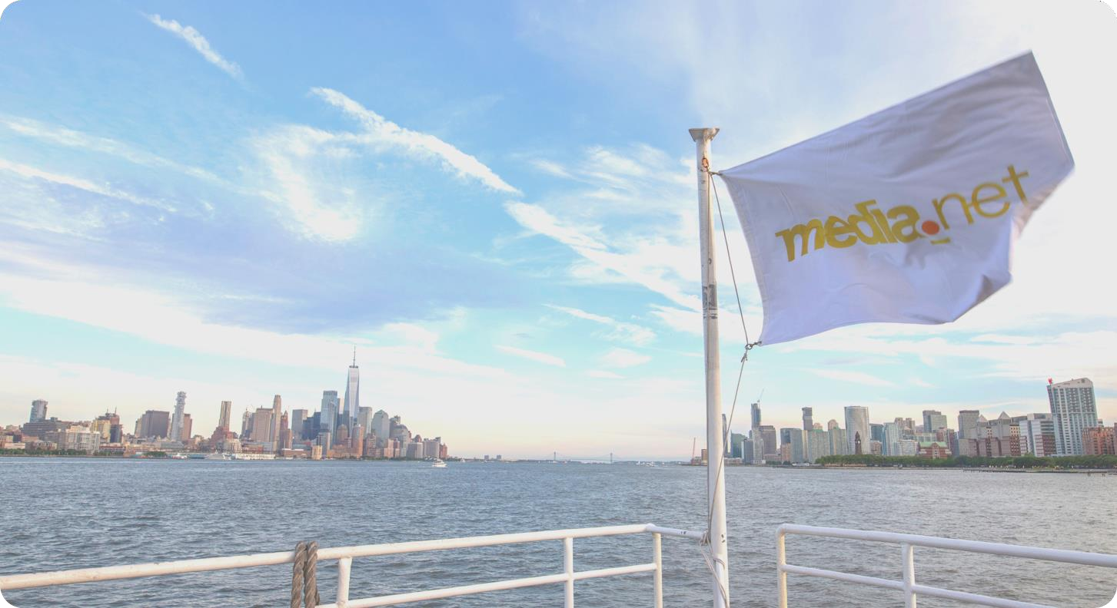
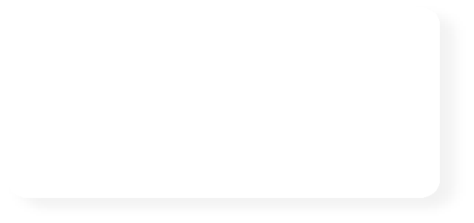




Media.net Has Been Quietly Helping Publishers Move To Server-Side Bidding
Two years ago, Media.net started helping publishers move their header bidding partners to a speedier…
Media.net Launches Next Generation Ad Targeting at IAB Annual Leadership Meeting
Today at the Internet Advertising Bureau’s Annual Leadership Meeting (#IABALM)…
Media.net donates OpenRTB
3.0 converter code to IAB Tech Lab
Media.net yesterday announced the donation of code to help IAB Tech Lab…
Lost in translation: Gaining clarity around AdTech transparency
It is the latest and likely the most enduring concern to hit the advertising industry in recent times…
Thank you
White Ops, Media.net Partnership Extends Pre-Bid Fraud Protection For Brands
Media.net has announced a partnership with White Ops to extend protection across programmatic...
Media.net Bets Its Contextual Data Can Offset Death Of The Cookie
The amount of online media with audience data attached is shrinking, thanks to Apple…

